Slide 1
DES and AES algorithms

Slide 2
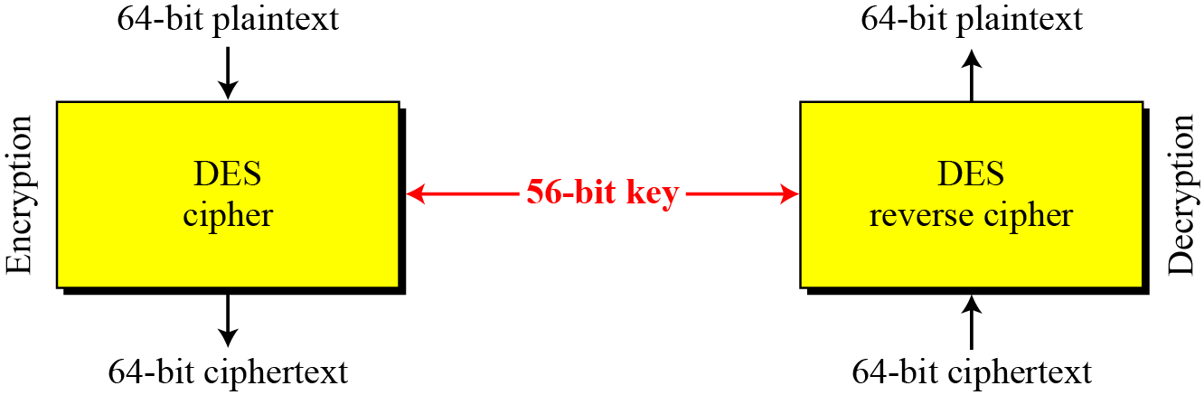
Data Encryption Standard
Modern symmetric key block cipher
Published by National Institute of standards and technology(NIST).
Encryption and decryption with DES

Slide 3
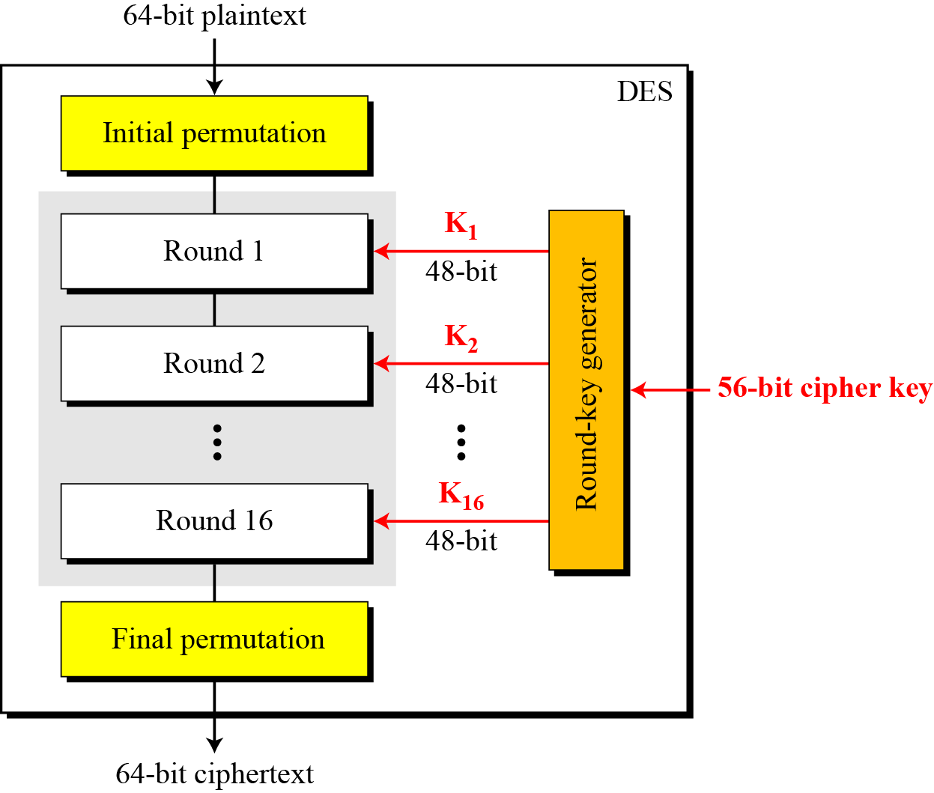
The encryption process is made of two permutations (P-boxes), which we call initial and final permutations, and sixteen Feistel rounds.
Each round uses a different 48 bit round key generated from the 56- bit cipher key.

Slide 4
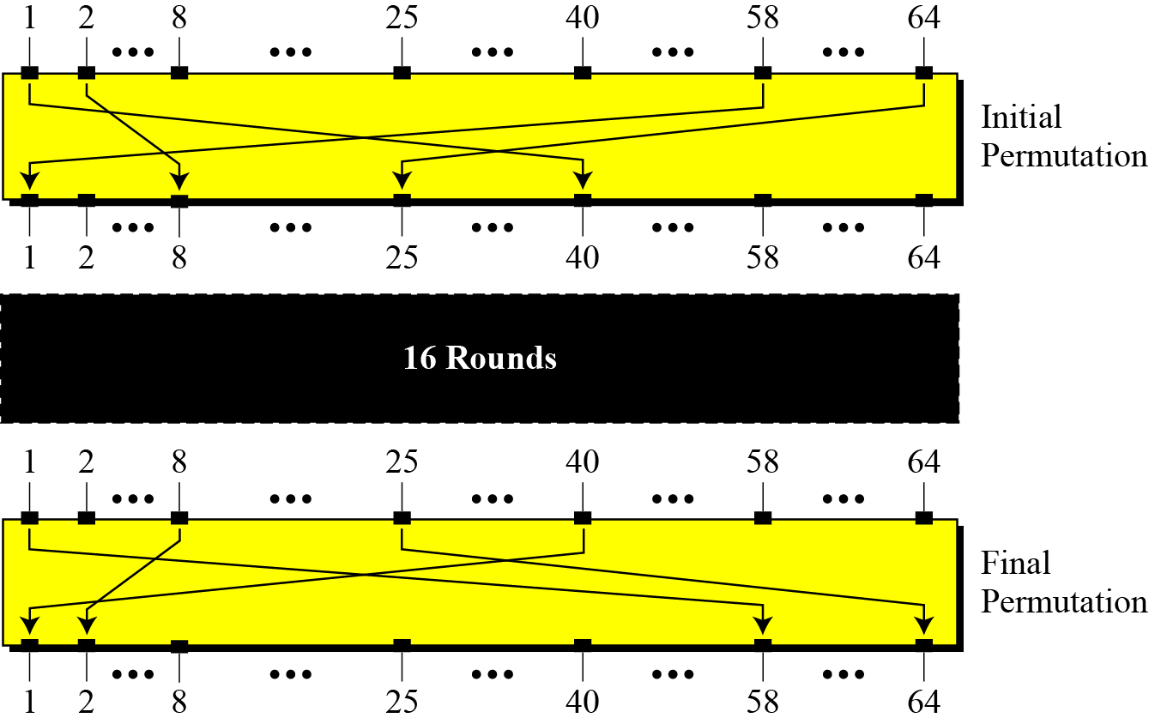
Initial and final permutation steps in DES

Slide 5
Initial and final permutation tables
Each of these permutations take 64 bit input and permutes the bits according to a predefined rule. Eg in the initial permutation 58th bit in the input becomes bit no 1 and so on…

Slide 6
Rounds
DES uses 16 rounds. Each round of DES is a Feistel cipher.
Each round has 2 cipher elements :
Mixer
Swapper
Each of these is invertible.
The mixer is invertible because of the Xor operation.
All the non invertible elements are collected inside f(Ri-1,ki)

Slide 7
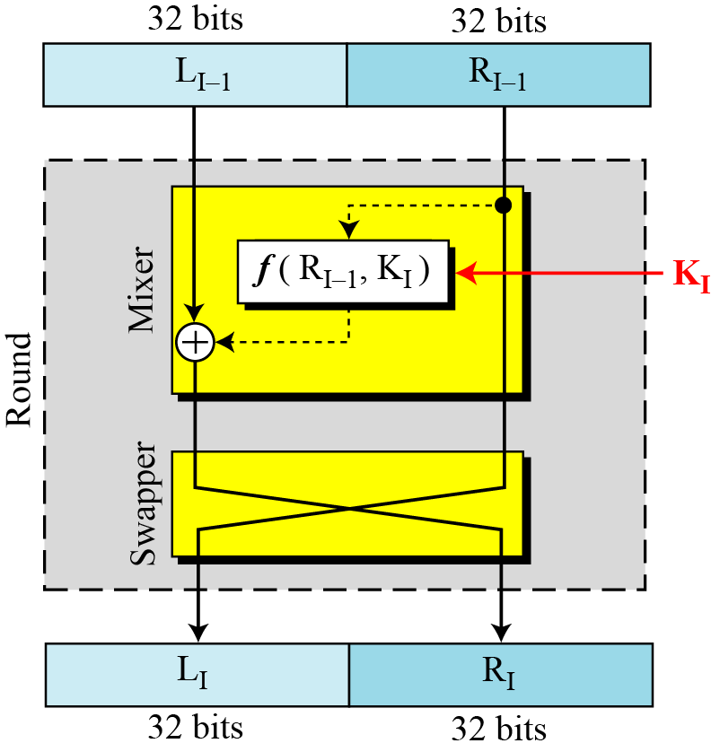
A round in DES

Slide 8
DES function
Heart of DES
Input to DES function→
1. 48 bit Key
2. Rightmost 32 bits
Output ->
32 bit output
DES function is made up of 4 sections.
1. Expansion Box
2. Whitener(XOR)
3. Group of S-boxes
4. A straight P-box

Slide 9
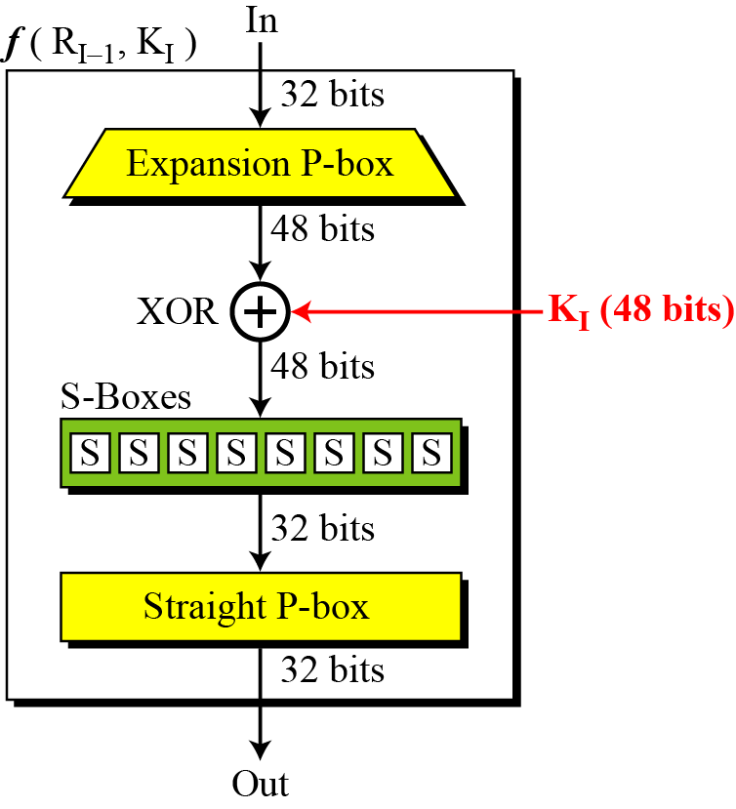
DES function

Slide 10
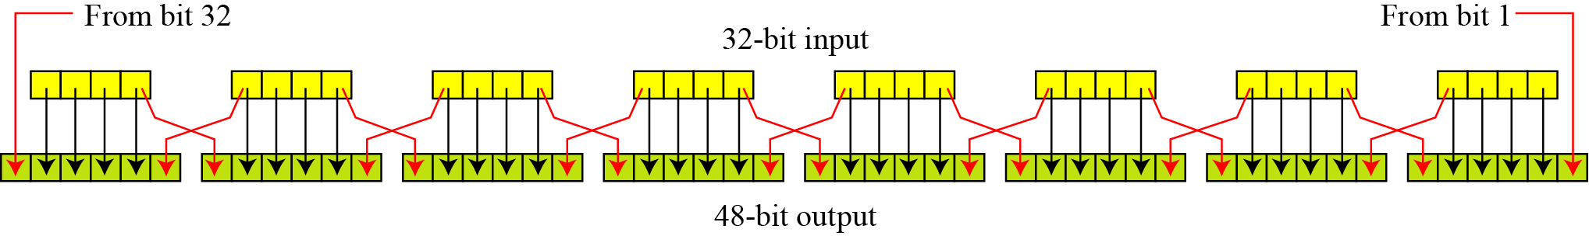
DES function
1. Expansion P- box
Since R_{I−1} is a 32-bit input and K_{I} is a 48-bit key, we first need to expand R_{I−1} to 48 bits.
R_{I−1} is divided into 8 4-bit sections
Each 4-bit section is expanded to 6 bits in the following manner :
Input bits 1,2,3,4 are copied to output bits 2,3,4,5 respectively.
O/p bit 1 comes from the input bit 4 of the previous section.
O/p bit 6 comes from input bit 1 of the next section.

Slide 11
DES function
Expansion P-box table

Slide 12
DES function
2. Whitener(XOR)
After the expansion permutation, DES uses the XOR operation
on the expanded right section and the round key.
Note : Both the right section and the key are 48-bits in length.
The 48-bit output goes as input to the S-box.
3. S-boxes
DES uses 8 S-boxes, each with a 6-bit input and a 4-bit output.
Substitution follows a predetermined rule :
Outer 2 bits of the 6 bit input select the row.
Inner 4 bits select the column.

Slide 13
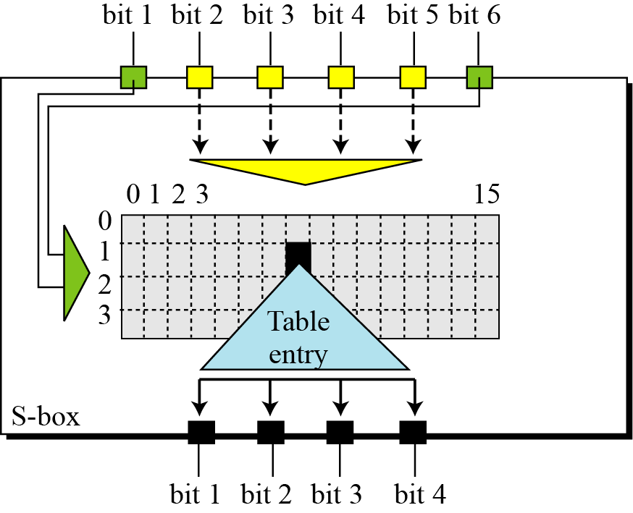
DES function

Slide 14
DES function
Note : Each S-box has its own table
S box 1

Slide 15
DES function
4. Straight P-box

Slide 16
Key Generation
The round-key generator creates sixteen 48-bit keys out of a 56-bit cipher key.
The cipher key is actually a 64-bit key in which 8 extra bits are the parity bits which are dropped before the actual key generation process.
Process :
1. Parity Drop :
Parity drop step is called the compression transposition step.
Step 1 : Drop the parity bits (bits 8,16,24,32,40,48,56,64) from the 64-bit key.

Slide 17
Key Generation
Step2 : Permute the bits according to →

Slide 18
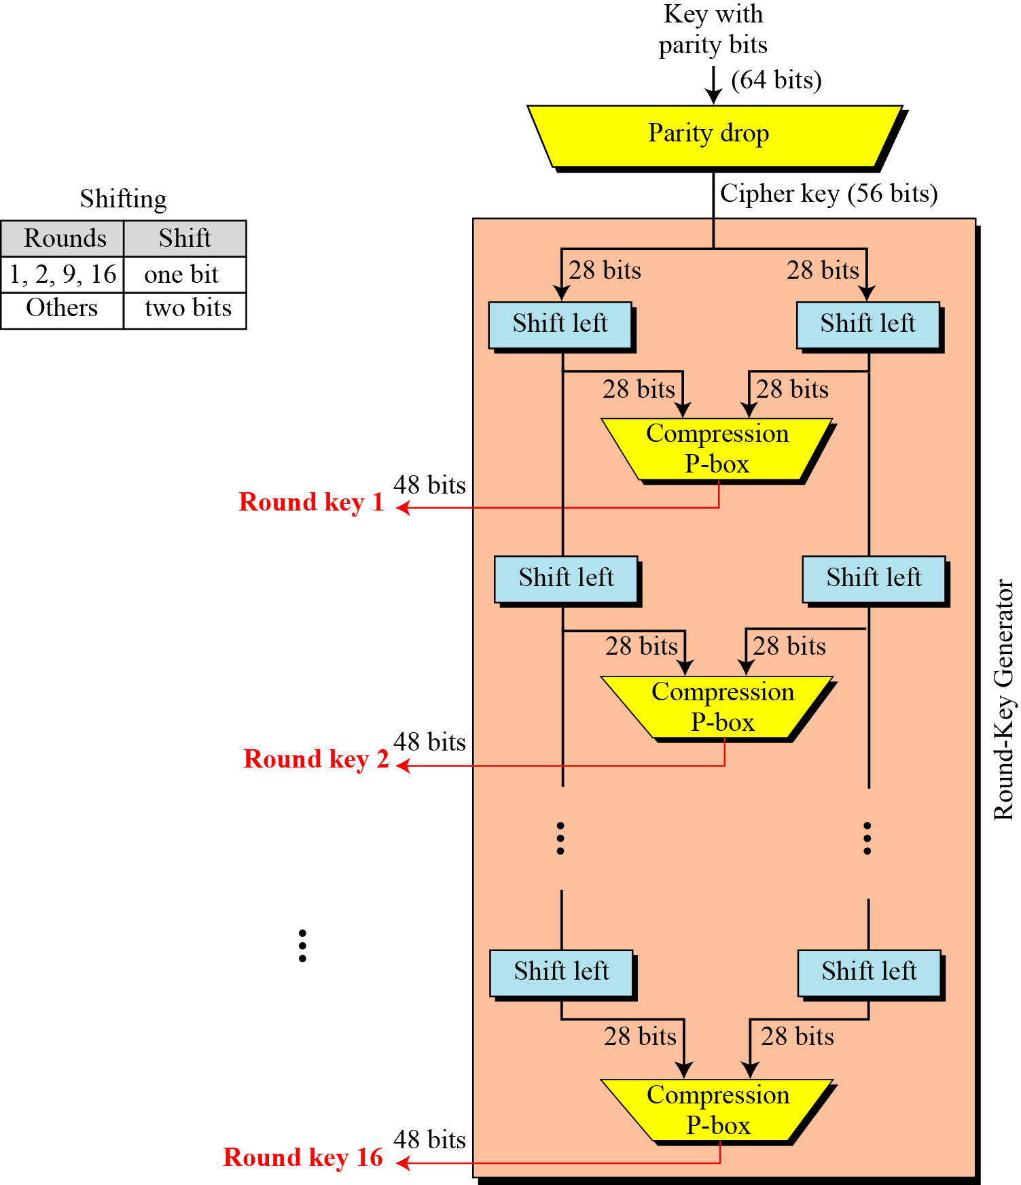
Key generation

Slide 19
Key Generation
2. Shift left :
Key is divided into 2 parts and each part is shifted left (circular) 1 or 2 bits; depending on the round.
The 2 parts are then combined to form a 56-bit part.
3. Compression box :
Changes 56 bits to 48 bits which are used as a key for a round.

Slide 20
Triple DES
The DES algorithm itself had become obsolete and was in need of replacement.
To this end, the National Institute of Standards and Technology (NIST) ratified the Advanced Encryption Standard (AES) as a replacement for DES.
Triple DES had been endorsed by NIST as a temporary standard to be used until AES was finished.
Triple DES uses a "key bundle" which comprises three DES keys, K₁, K₂ and K₃, each of 56 bits (excluding parity bits)
Each triple encryption encrypts one block of 64 bits of data.

Slide 21
Triple DES
The encryption algorithm is:
ciphertext = E_{K3}(D_{K2}(E_{K1}(plaintext)))
i.e., DES encrypt with K₁, DES decrypt with K₂, then DES encrypt with K₃.
Decryption is the reverse:
plaintext = D_{K1}(E_{K2}(D_{K3}(ciphertext))) I.e., decrypt with K₃, encrypt with K₂, then decrypt with K₁

Slide 22
Triple DES
K1
K2
K3
A
B
E
D
E
P
C
(a) Encryption
K3
K2
K1
B
A
D
E
D
C
P
(b) Decryption

Slide 23
Triple DES
Keying options
The standards define three keying options:
Keying option 1:
All three keys are independent.
Keying option 2:
K₁ and K₂ are independent, and K₃ = K₁.
Keying option 3: All three keys are identical, i.e. K₁ = K₂ = K₃.
Note : Keying option 1 is the strongest, with 3 × 56 = 168
independent key bits.
Keying option 2 provides less security, with 2 × 56 =
112 key bits.
Keying option 3 is equivalent to DES, with only 56 key bits
because the first and second DES operations cancel out

Slide 24

The Advanced Encryption Standard (AES) is a symmetric-key block cipher published by the National Institute of Standards and Technology (NIST) in December 2001.
AES is a non-Feistel cipher that encrypts and decrypts a data block of 128 bits.
It uses 10, 12, or 14 rounds.
The key size, which can be 128, 192, or 256 bits, depends on the number of rounds.
But the round keys are always 128 bits.
3 versions are : AES - 128
AES - 192
AES - 256

Slide 25

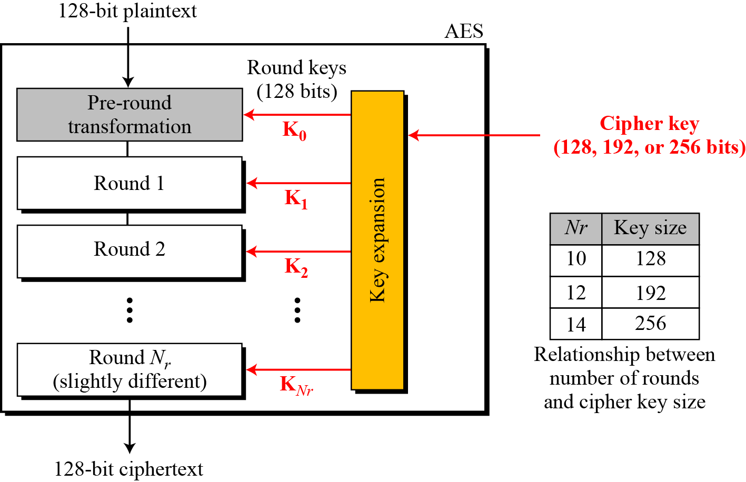

Slide 26
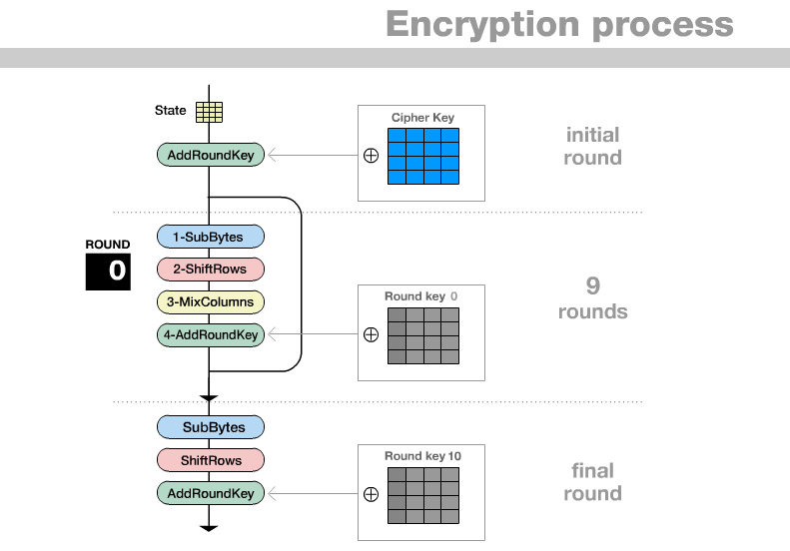

Slide 27
Structure of AES
The 128 bit block of plaintext (16 bytes) is organized as a 4 x 4 matrix called the state
Hence we have s[0,0]……s[3,3]
i.e if inputs are 16 bytes (bo, b1……..b15)
They are represented as
s(i,j)
i-→ 0-3 bo b4 b8 b12
j-→0-3 b1 b5 b9 b13
b2 b6 b10 b14
b3 b7 b11 b15

Slide 28
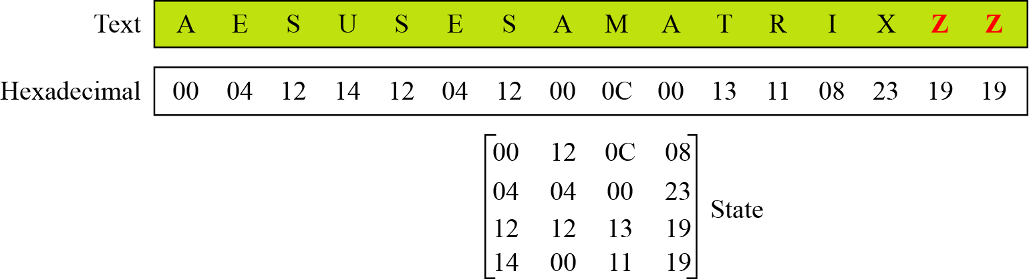

Slide 29
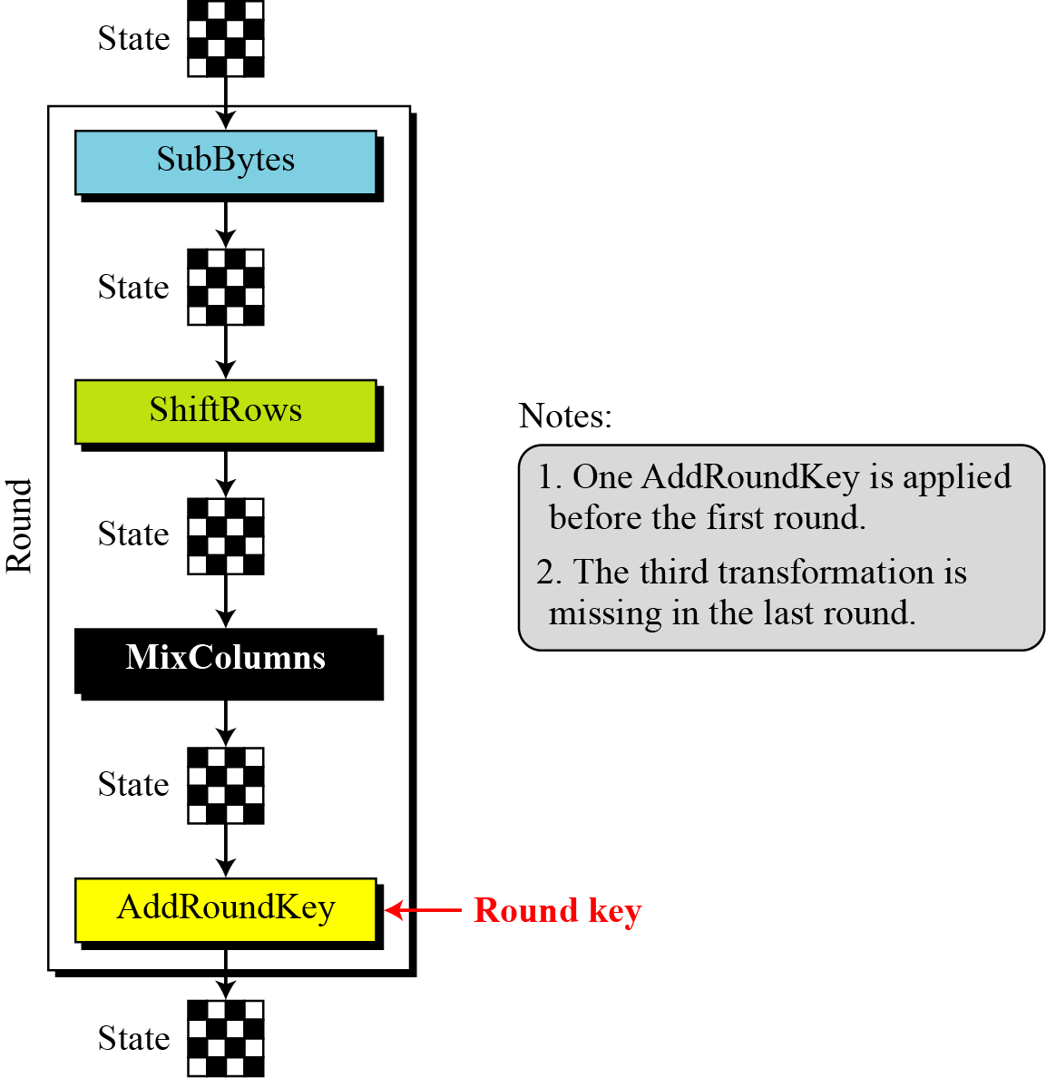
Each round consists of 4 operations :
Byte Substitution
Shift row
Mix column
Add round key

Slide 30
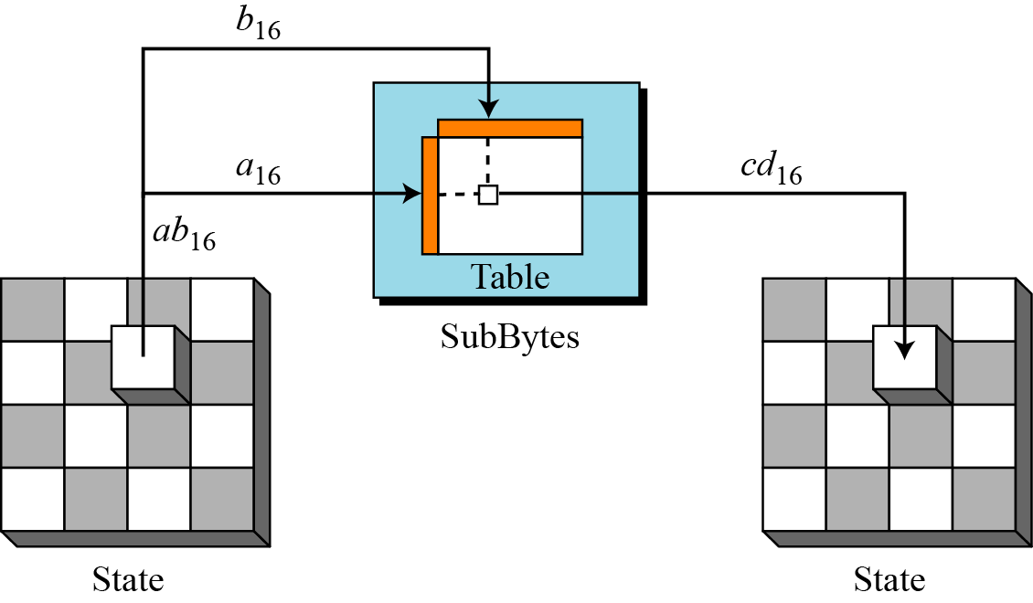
1. Byte Substitution
s(i,j) becomes s’(i,j) through a defined substitution table.
To substitute a byte, we interpret the byte as two hexadecimal digits.
Each byte b is replaced by another byte based on the sub bytes transformation table.

Slide 32
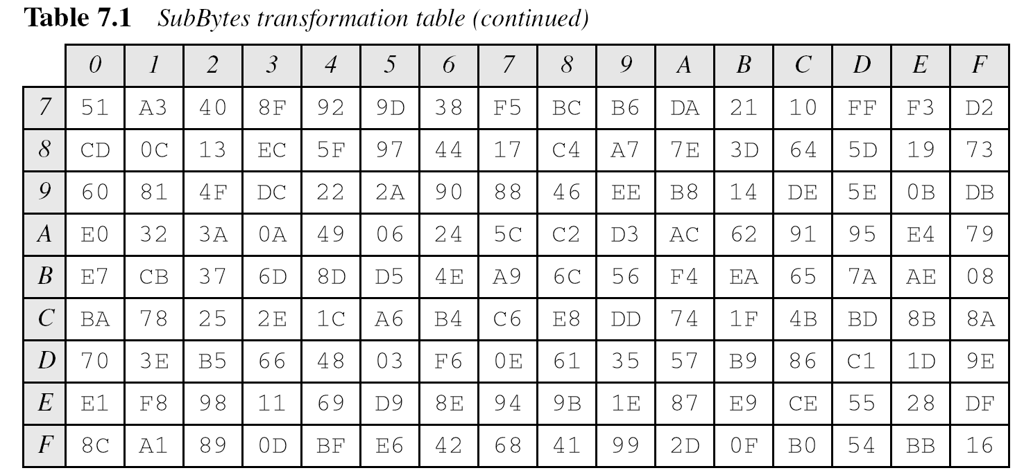
(00100000)₂ = (20)₁₆
This byte is replaced by B7 (i.e. row 2 and column 0)

Slide 33
In decryption we have Inverse Sub bytes transformation

Slide 34
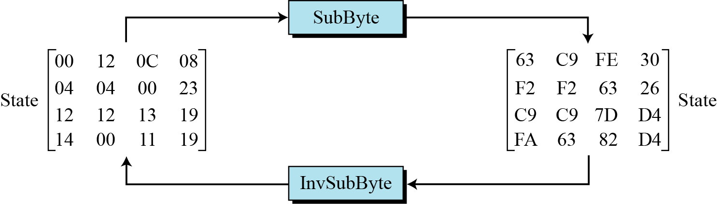
The SubBytes and InvSubBytes transformations are inverses of each other.

Slide 35
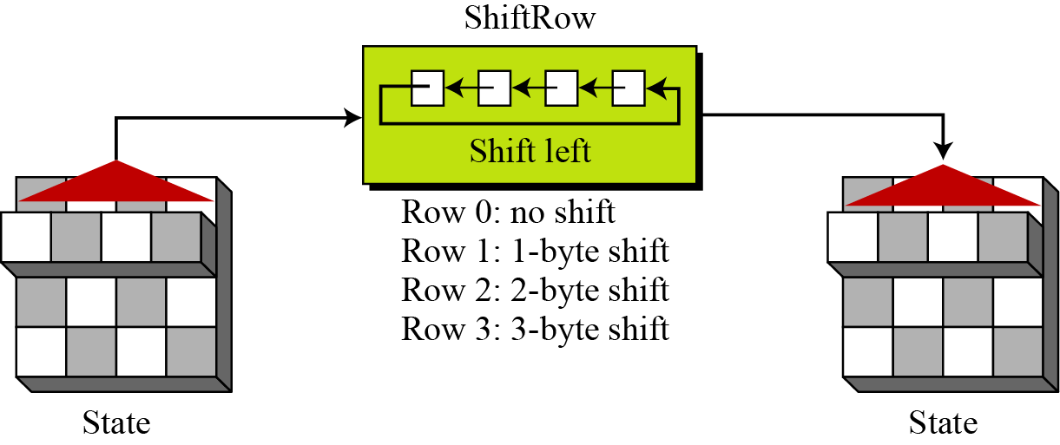
2. Shift row
Each row of s’ undergoes a circular left shift.
Each row i is shifted left circular by i bytes where i → 0-3

Slide 36
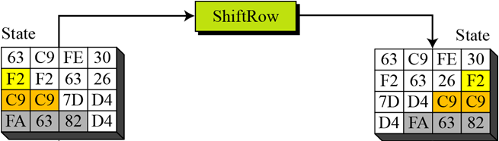
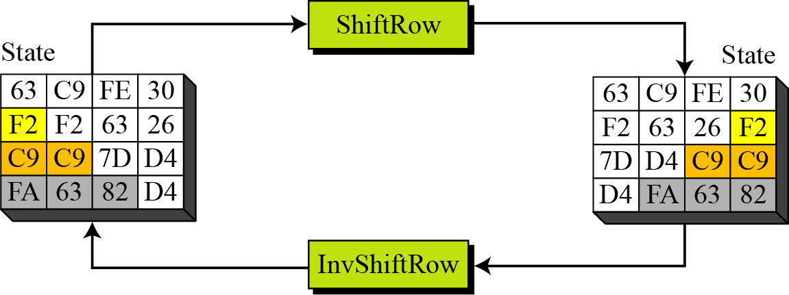
InvShiftRows
In the decryption, the transformation is called InvShiftRows and the shifting is to the right.

Slide 37
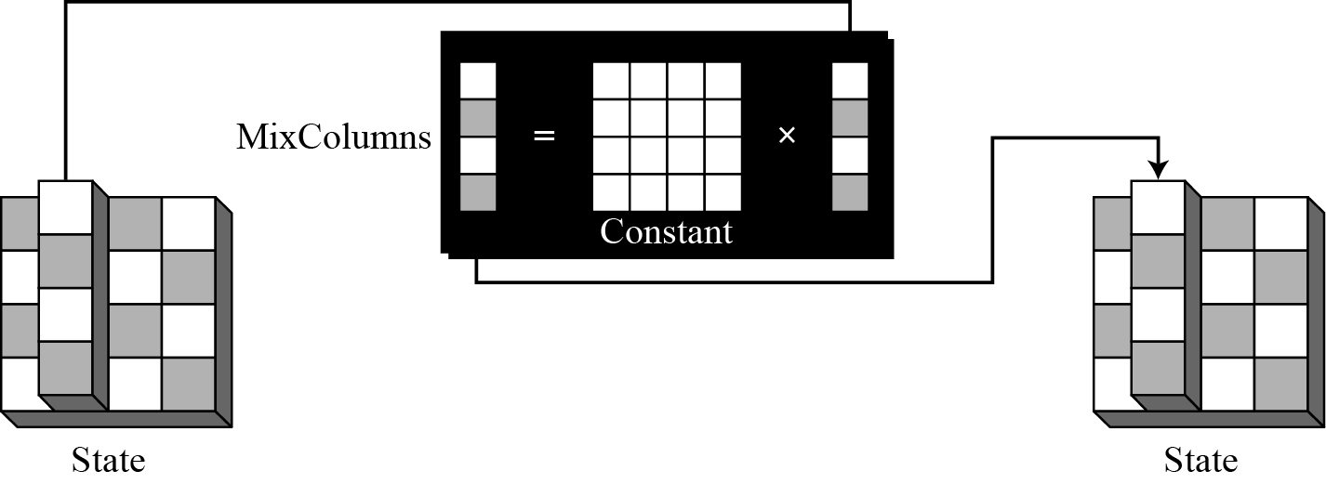
3. Mix columns
4 elements of each column are multiplied by a constant matrix
The MixColumns transformation operates at the column level; it transforms each column of the state to a new column.

Slide 38
Byte substitution changes the value of the byte based on the
original value and an entry in the table;changing a byte does
not affect the neighboring bytes.
Similarly shifting rows exchanges bytes without permuting the
bits inside the bytes.
But what we need is an interbyte transformation that changes
the bits inside the byte, based on the bits inside the
neighboring bytes.
i.e. we need to mix bytes to provide diffusion at the bit level.
This is done by taking 4 bytes at a time and combining them to
recreate 4 new bytes.

Slide 39
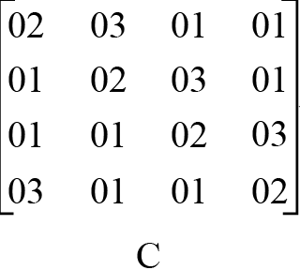
This is achieved by multiplying a square matrix(constant) by a column matrix, result is a new column matrix

Slide 40

Note :
Multiplying by 1 means leaving it unchanged
Multiplying by 2 means shifting each byte left 1 bit and exoring with 0001 1011 if the leftmost bit of the original value (before the shift) is 1
Multiplying by 3 means shift left one bit and ex-oring with the
original unshifted value and exoring with 0001 1011 if the leftmost bit of the original value (before the shift) is 1
InvMixColumns
The InvMixColumns transformation is basically the same as the MixColumns transformation.
The MixColumns and InvMixColumns transformations are inverses of each other.

Slide 41
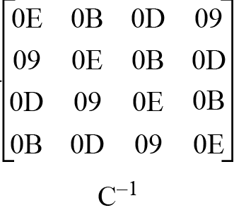
InvMixColumns
The InvMixColumns transformation is basically the same as the MixColumns transformation.
The MixColumns and InvMixColumns transformations are inverses of each other.

Slide 42
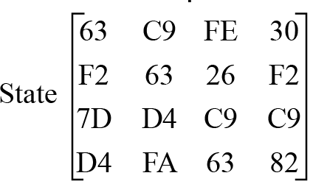

After row shifting
Taking the first column
x

Slide 43

=
0110 0011 – after left shifting--- 1100 0110
1111 0010 ---- after left shifting--- 1110 0100 exor 1111 0010 exor 0001 1011
0111 1101 --- leave unchanged
1101 0100 --- leave unchanged
11 00 0110
0000 1101
0111 1101
1101 0100
0110 0010 (62)

Slide 44
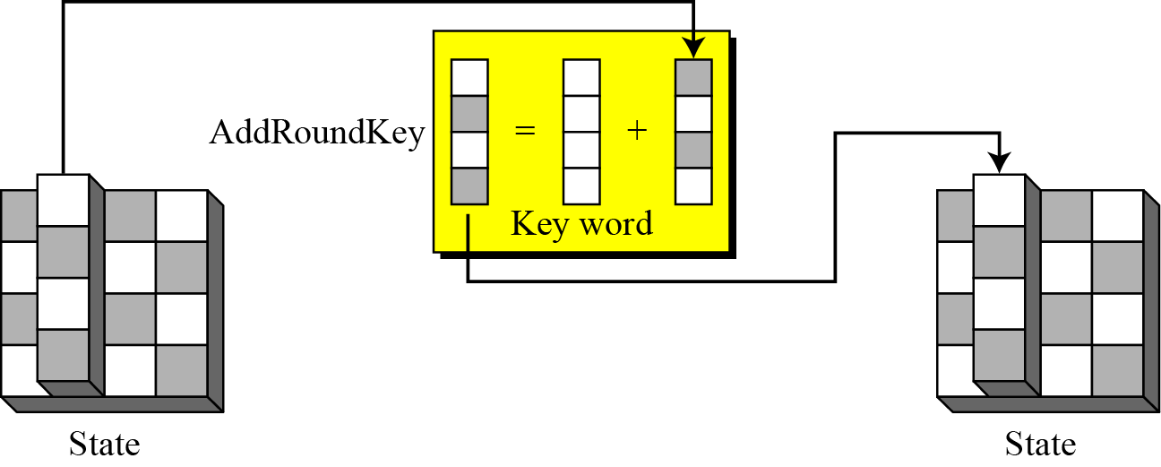
Step 4 : Add round key
The final step is to ex-or the key with the result so far.

Slide 45

To create round keys for each round, AES uses a key-expansion process. If the number of rounds is N_{r} , the key-expansion routine creates N_{r} + 1 128-bit round keys from one single 128-bit cipher key.
The key expansion routine creates round keys word by word , where a word is an array of 4 bytes.
In the AES-128 version(10 rounds) there are 44 words.
In the AES-192 version(12 rounds) there are 52 words.
In the AES-256 version(14 rounds) there are 60 words.
Each round key is made up of 4 words

Slide 46

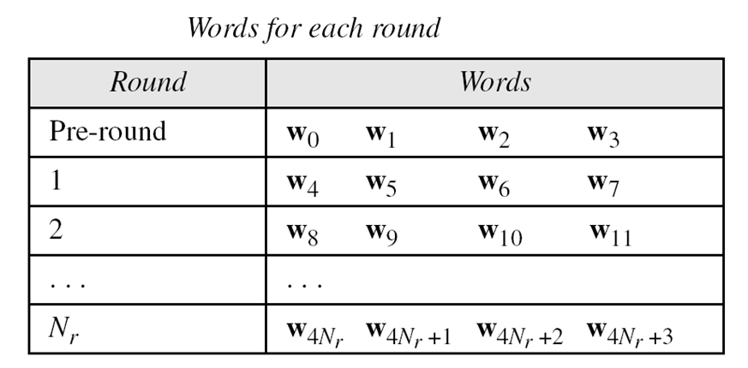

Slide 47
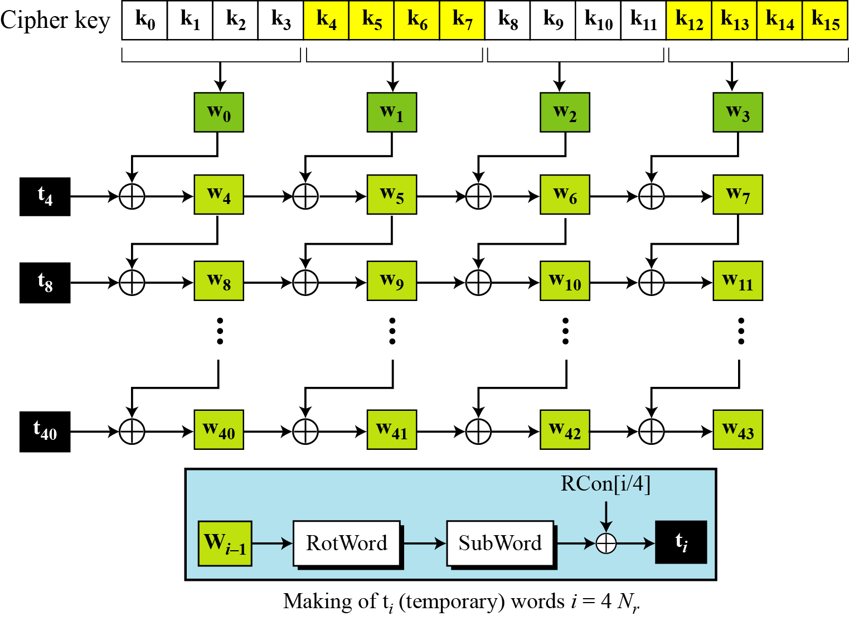
Creation of words from the original cipher key(128 bits)

Slide 48

The process is as follows :
The first four words( w0,w1,w2,w3) are made directly from the cipher key.
The cipher is an array of 16 bytes(k0 to k15). The first 4 bytes (k0 to k3) become w0; the next 4 bytes (k4 to k7) become w1; and so on. i.e the concatenation of first 4 words replicates the cipher key.
The rest of the words( wi for i=4 to 43) are made as follows:
1. If ( i mod 4) ≠ 0, w_{i}=w_{i-1} ⊕ w_{i-4}. i.e each word is made
from the one at the left and the top.
2. If ( i mod 4) = 0, w_{i}=t ⊕ w_{i-4}. Here t is a temporary word,
t is the result of applying 2 routines Subword and rotword on
w_{i-1} and exoring the result with a round constants RCon.
t= Subword ( Rotword( w_{i-1} ) ) ⊕ Rcon_{i/4}

Slide 49

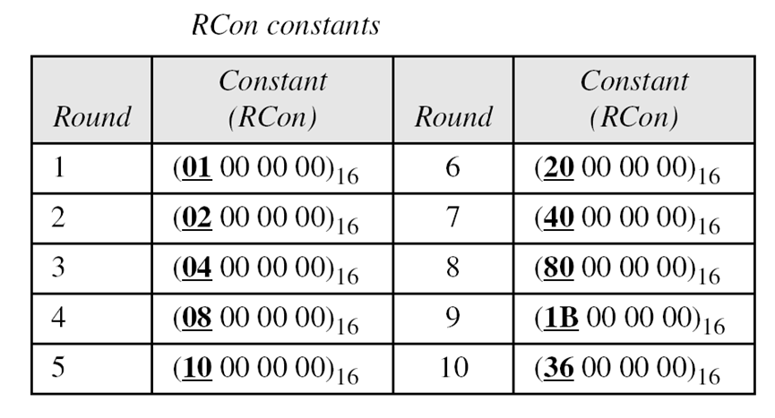
Rotword : Rotate Word routine is similar to ShiftRows transformation, but it is applied to only one row. The routine takes a word as an array of 4 bytes and shifts each byte to the left with wrapping.
Subword : The Subword (Substitute word) routine is similar to the subBytes transformation , but is applied to only 4 bytes. The routine takes each byte in the word and substitutes another byte for it.

Slide 50
Following slide shows how the keys for each round are calculated assuming that the 128-bit cipher key agreed upon by Alice and Bob is (24 75 A2 B3 34 75 56 88 31 E2 12 00 13 AA 54 87)₁₆.
In each round , the calculation of the last three words are very simple. For the calculation of the first word we need to first calculate the value of the temporary word (t).
For example the first t for round 1 is calculated as----
24 75 A2 B3 34 75 56 88 31 E2 12 00 13 AA 54 87
w0 w1 w2 w3
Rotword(13 AA 54 87 ) = AA 54 87 13
Subword(AA 54 87 13) = AC 20 17 7D
t = AC 20 17 7D ⊕ 01 00 00 00 = AD 20 17 7D
To form w04 ---- w04= t ⊕ w_{i-4} = AD 20 17 7D ⊕ 24 75 A2 B3 = 89 55 B5 CE

Slide 52
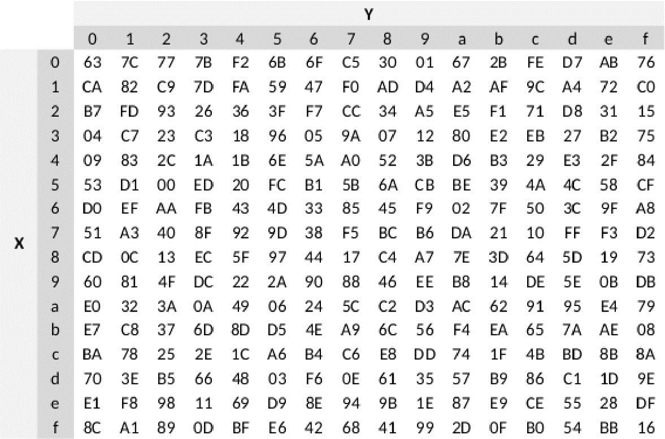
S-box for key expansion

